Slide 1

Oman Academic Accreditation
Authority (OAAA)
Oman Qualifications Framework Project
OQF Oversight Committee
25 June 2014
Notes:
1

Slide 2
Outline
Meeting Objectives
About the OAAA
  OAAA Vision and Mission
  OAAA Administrative Divisions
What is a Qualifications Framework?
Oman Qualifications Framework
Current OQF Project
  Project Objectives
  The OQF Oversight Committee
  External experts
Next Steps
  Action Plan

Slide 3
Abbreviations
CEO Chief Executive Officer
HEI Higher Education Institution
ILO International Labour Organisation
MoE Ministry of Education
MoHE Ministry of Higher Education
MoM Ministry of Manpower
NQF National Qualifications Framework
OAAA Oman Academic Accreditation Authority
OCCI Oman Chamber of Commerce and Industry
OQF Oman Qualifications Framework
OQNHE Oman Quality Network in Higher Education
QF Qualifications Framework
ROSQA Requirements of Oman’s System for Quality Assurance
ToR Terms of Reference
VET Vocational Education and Training

Slide 4
1. Meeting objectives
To introduce members of the Oversight Committee
To clarify the role and terms of reference of the Oversight Committee
To inform Committee members of the background to the OQF project
To develop an understanding of the OQF development process through a regional agency’s experience
To consider the draft proposal with the external partner

Slide 5
2. About the OAAA

Slide 6
OAAA Vision and Mission
OAAA
OAAA Vision
OAAA aspires to be an internationally recognized authority for the accreditation and promotion of quality in higher education in Oman.
OAAA Mission
To encourage and support the Omani higher education sector in meeting international standards; to maintain the national qualifications framework; and, through a transparent rigorous system of institutional and program accreditation, provide reliable information to the public and other stakeholders on the quality of higher education in Oman.
OAAA Mission
To encourage and support the Omani higher education sector in meeting international standards; to maintain the national qualifications framework; and, through a transparent rigorous system of institutional and program accreditation, provide reliable information to the public and other stakeholders on the quality of higher education in Oman.
Notes:
6

Slide 7
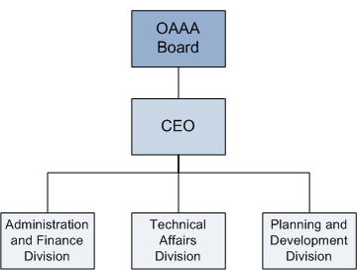
OAAA Administrative Divisions
OAAA Executive Office

Slide 8

OAAA Staff 2013

Slide 9
3. What is a Qualifications Framework?

Slide 10
What is a
Qualifications Framework?
A Qualifications Framework is an instrument for the development, classification and recognition of skills, knowledge and competencies along a continuum of agreed levels. It is a way of structuring existing and new qualifications, which are defined by learning outcomes, i.e. clear statements of what the learner must know or be able to do whether learned in a classroom, on-the-job, or less formally. The Qualifications Framework indicates the comparability of different qualifications and how one can progress from one level to another, within and across occupations or industrial sectors (Tuck, 2007)

Slide 11
Growth in NQFs
In the 1990s, less than 10 countries had NQFs
In 2012, more than 110 countries have or are developing an NQF (Abou-Ela, 2012)
Regionally, Bahrain; UAE; Saudi Arabia have all developed academic or comprehensive NQFs; Qatar is in the process of developing its NQF.
According to the International Labour Organisation (Allais, 2010):
  there is no single right model of NQFs,
  NQFs do not provide quick-fix or simple solutions to the complex problems facing countries in relation to education, skills development, and employment.
  NQFs face challenges in implementation
  Not all NQFs achieve their goals

Slide 12
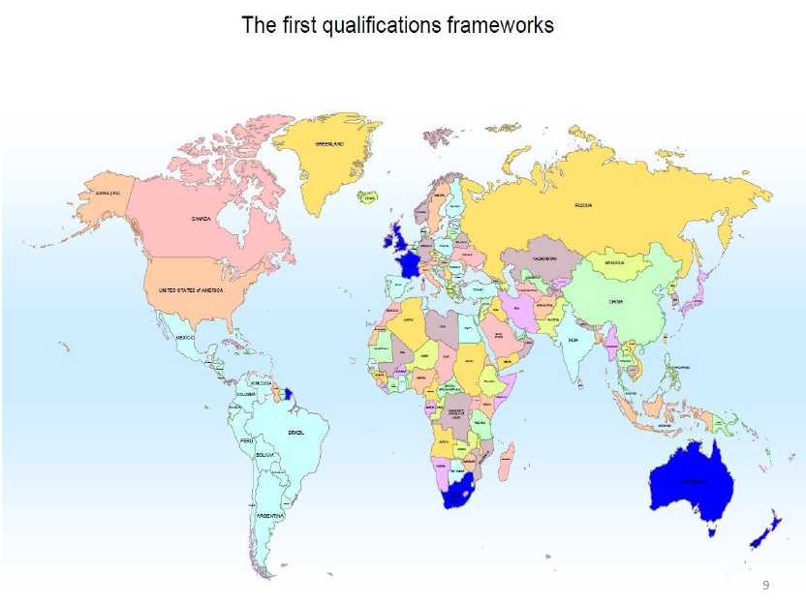
Abou-Ela, 2012

Slide 13
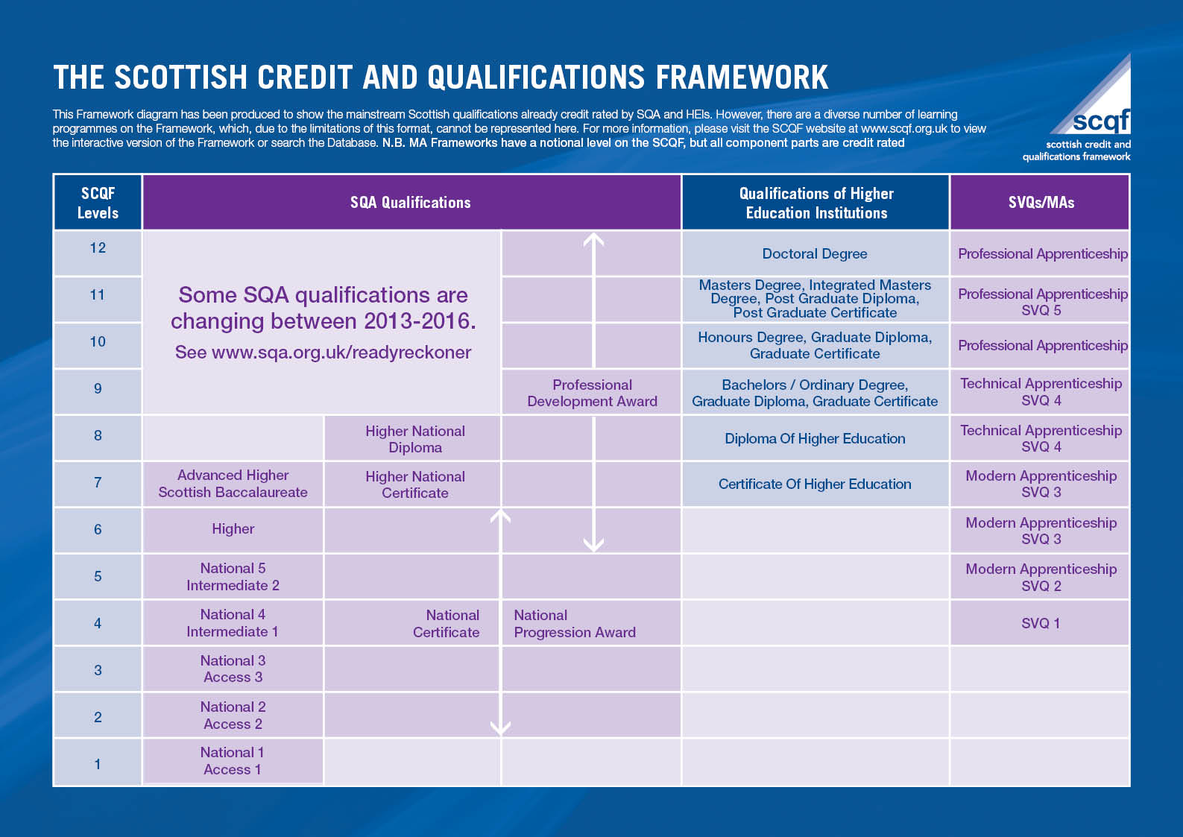

Slide 14
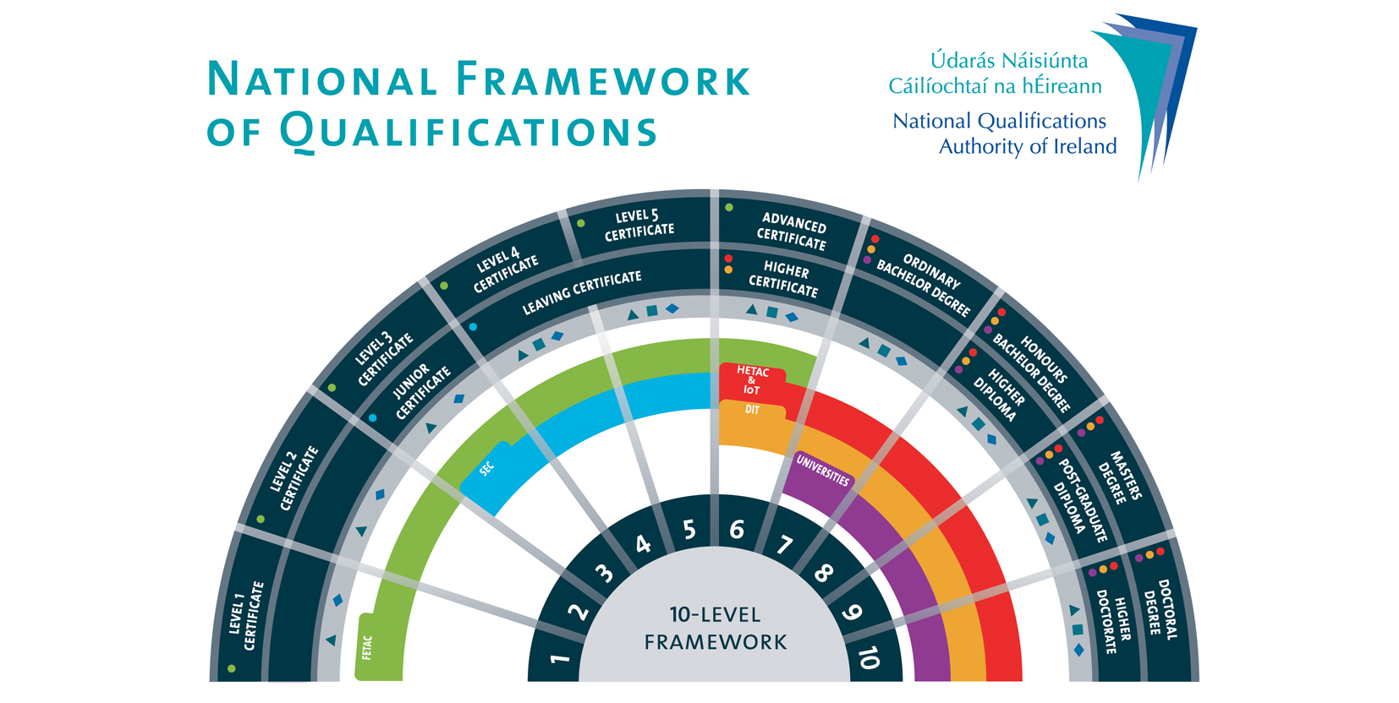

Slide 15
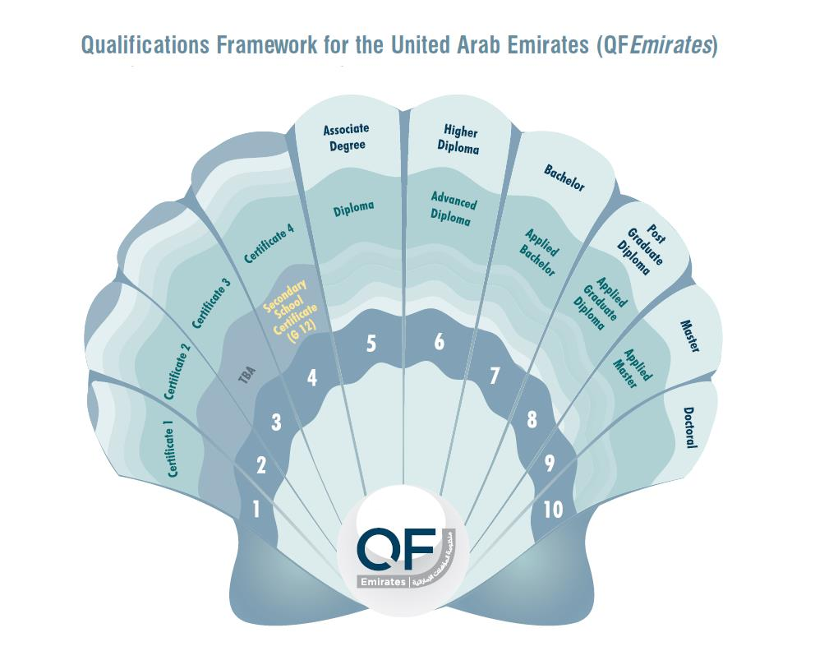

Slide 16
Why is a Qualifications Framework useful?
A qualifications framework is intended to improve understanding of qualifications (degrees, certificates, or recognition of experiential-based learning and capabilities) in terms of the information they convey to an employer about prospective workers’ competencies. Frameworks are also intended to explain how qualifications relate to each other and thus can be combined to build pathways within education systems. (Allais, 2010)

Slide 17
Why is a Qualifications Framework useful?
An NQF can be used by a number of stakeholders for different purposes, for example:
  HEIs, schools, vocational and training centres can use a QF in order to support the design of their curricula, education and training programs
  Quality assurance bodies can use a QF to underpin licensing and accreditation processes; in Oman, the current OQF is used by
    MoHE to support licensing activities
    OAAA to support accreditation activities

Slide 18
Why is a Qualifications Framework useful?
  For students, a QF clearly indicates the knowledge and skills associated with different types of qualifications and provides pathways within and across different types of education
  For employers, a QF provides a clear indication of the level, knowledge and skills that an applicant has attained whether through academic, vocational or professional training
  For employers and employees, a QF provides a means of supporting professional development within organisations

Slide 19
4. Oman Qualifications Framework

Slide 20
Oman Qualifications Framework
In Oman, the overall responsibility for developing and maintaining the Oman Qualifications Framework (OQF) rests with the OAAA, as determined by Royal Decree 54/2010.
The Royal Decree outlines the following responsibilities for the OAAA:
In March 2014 the Education Council issued a decision stating that the OAAA is responsible for developing the OQF which covers academic, vocational, professional and school education.
  Developing and updating the Oman Academic Qualifications Framework in collaboration with the Ministry of Higher Education and other relevant authorities (Article 8, E).
  Responsibilities include any other issues assigned by the (Higher) Education Council related to the Authority’s Terms of Reference (Article 8, J).

Slide 21
Oman Qualifications Framework
The first OQF was developed as part of ROSQA in 2003/2004.
The Arabic version was approved by the OAAA Board in 2005.
The current framework includes post secondary academic qualifications only.
The OQF describes the six levels, minimum credit points/hours and the academic awards.
The OQF also includes descriptors for each qualification in terms of knowledge, cognitive skills and general competencies.

Slide 22
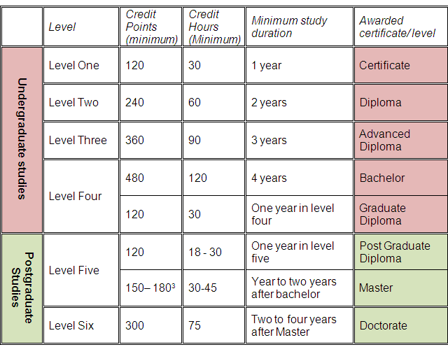

Slide 23
5. Current OQF Project

Slide 24
Current project
The OAAA submitted a proposal to review the current OQF and develop a comprehensive national QF in 2012
Planning for the Education Strategy 2040 highlighted the importance of having a national QF for Oman; the OAAA suggested adding a recommendation to develop a comprehensive OQF in the national strategy.
The MoE/World Bank Report in 2012 also called for a national qualifications framework to be established in Oman; in 2014, the MoE approached the Scottish Qualifications Authority to be an external partner in developing the OQF

Slide 25
Project objectives
Define the purpose of the OQF in line with national goals in consultation with a range of key stakeholders
Develop a comprehensive rationale which clearly justifies the characteristics of the framework in relation to Oman’s context and the strategic goals
Develop a comprehensive plan for the effective implementation and maintenance of the framework
Develop clear measurable outcomes in order to evaluate the extent to which the implementation of the OQF will have been successful.

Slide 26
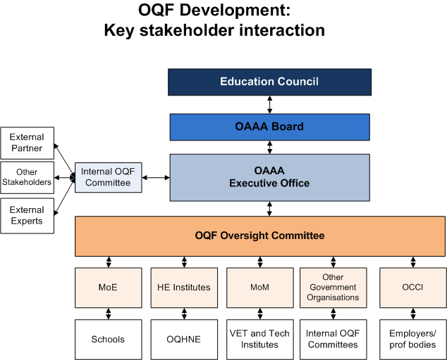
OAAA

Slide 27
Role of the OAAA
The project will be led by the OAAA.
The OAAA is in the process of recruiting a project manager.
An internal OQF Committee will be established.
The OAAA will liaise with the Oversight Committee, the external partner and the panel of external experts.
Feedback will be collated and draft versions of the OQF will be updated.
The OAAA will work with the external partner.
The final draft of the OQF will be approved by the OAAA Board prior to submission to the Education Council for final approval.

Slide 28
OAAA

Slide 29
Role of OQF Oversight Committee
The role of the Oversight Committee is to:
  Decide on project outcomes
  Set features of the OQF
  Represent key stakeholders in the project to develop and implement a comprehensive national qualifications framework in Oman
  Ensure that the development of a comprehensive OQF is carried out in full consultation with the key stakeholders in Oman
  Provide feedback at different stages of the project

Slide 30
Committee Membership
Ministry of Defence
Ministry of Health
Ministry of Civil Service
Oman Medical Specialty Board
Sultan Qaboos University
Private HEIs
Employers
OCCI
Diwan of Royal Court
Secretariat General,
Education Council
OAAA
Ministry of Education
Ministry of Higher Education
Ministry of Manpower
Supreme Planning Council

Slide 31
How will the Oversight
Committee work?
Committee members are expected to:
  Consider and provide feedback on draft documentation (circulated via email where possible)
  Participate in scheduled face to face meetings
  Act as a liaison between the committee and the organisation they are representing, sharing documents in order to solicit views of colleagues at all stages of the project in order to ensure a comprehensive consultation process.
  Pass on feedback from their organisation to the Committee
  Participate in workshops and/or seminars
  Work in English and Arabic (the OQF will be developed bilingually)

Slide 32
OAAA

Slide 33
Role of the External Partner
The role of the External Partner (for example the Scottish Qualifications Authority) is to:
  Conduct a comprehensive needs analysis
  Carry out extensive benchmarking
  Develop a draft conceptual design for the OQF
  Develop design features of the OQF
  Develop policies and procedures to support the management of the OQF
  Pilot mapping activities
  Develop mechanisms to monitor effectiveness
  Produce the final OQF and implementation plan

Slide 34
OAAA

Slide 35
The Role of External Experts
The OAAA will form a panel of external experts to comment on draft documentation.
The panel will include experts from international and regional QF agencies.
External experts will be expected to comment on draft documentation.
  This will support international benchmarking of the OQF development and implementation process.
  This aims to ensure that the OQF is developed in line with best practice.

Slide 36
6. Next steps
Collate feedback on draft proposal from Oversight Committee
Amend project proposal in light of feedback
Identify external partner
Negotiate Terms of Reference (ToR) and project outcomes with external partner
Schedule Oversight Committee meeting #2
Approve ToR and project outcomes
Follow Action Plan

Slide 37
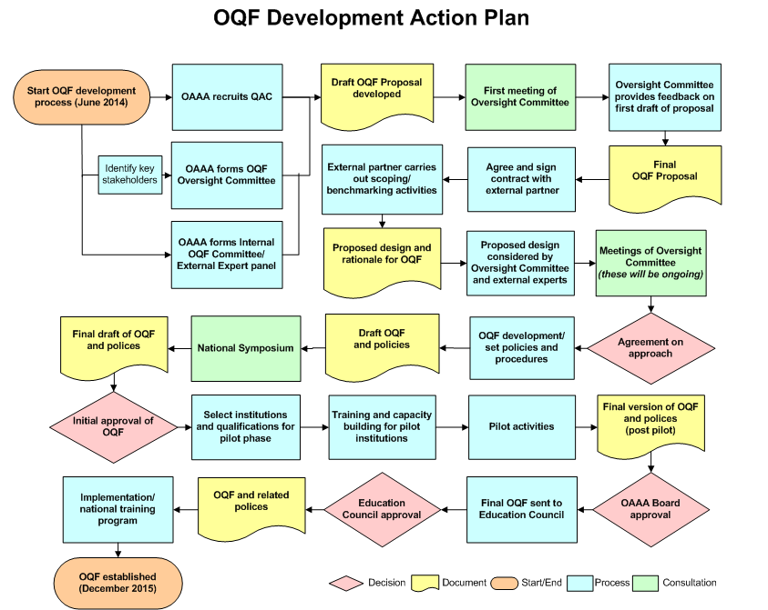
Action Plan

Slide 38
References
Abou-Ela, B (2012) UAE Qualifications Framework. Presentation delivered September 2012.
Allais, S. (2010), The implementation and impact of National Qualifications Frameworks: Report of a study in 16 countries. International Labour Organisation: Geneva.
Ministry of Education/World Bank (2012) Education in Oman: the Drive for Quality
Tuck, R. (2007), An Introductory Guide to National Qualifications Frameworks: Conceptual and Practical Issues for Policy Makers. International Labour Organisation: Geneva.

Slide 39

www.oaaa.gov.om

